Slide 1
Regular Expressions
14 -Sarthak Karkera
19-Vaibhav Kumar
21- Mansi Mashru
25 - Mrinal Paliwal

Slide 2
Introduction
A regular expression is a special sequence of characters that helps you match or find other strings or sets of strings, using a specialized syntax held in a pattern. Regular expressions are widely used in the UNIX world.
The Python module re provides full support for Perl-like regular expressions in Python. The re module raises the exception re.error if an error occurs while compiling or using a regular expression.

Slide 3
Introduction
A Regular Expressions (RegEx) is a special sequence of characters that uses a search pattern to find a string or set of strings.
It can detect the presence or absence of a text by matching with a particular pattern, and also can split a pattern into one or more sub-patterns.
Python provides a re module that supports the use of regex in Python.
Its primary function is to offer a search, where it takes a regular expression and a string. Here, it either returns the first match or else none.

Slide 4
RegEx Functions
General uses of regular expressions to:
Search a string (search)
Replace parts of a string (sub)
Break string into small pieces (split)
Finding a string (findall)

Slide 5
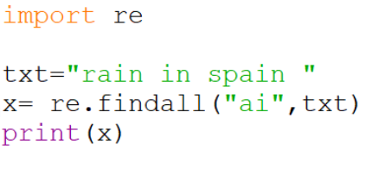
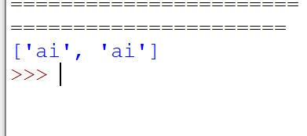
findall()

Slide 6
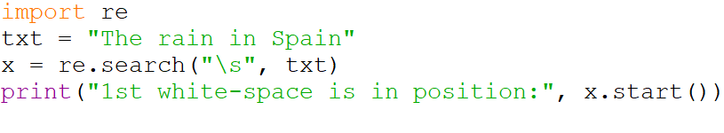

search()

Slide 7
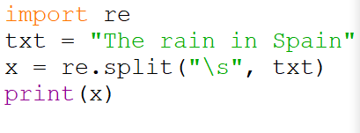

split()

Slide 8
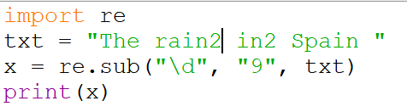
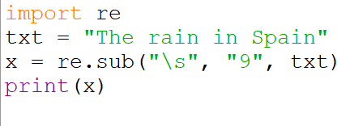


sub()

Slide 9
Special Characters
It is special characters function which is use to search in pattern to find string or set of string.
It is provided with re module which provide with different module
Some metacharacters are:\,[],^,$,.
It gives the regular expression their power and flexibility

Slide 10

\-backslash
Used to drop the special meaning of characters
Code:-
import re
s="The most recent major version of Python is Python 3, which we shall be using in this tutorial.However, security updates"
match=re.search(r'\,',s)
ma=re.search(r'\.',s)
print(match)
print(ma)

Slide 11
^Caret
It is use to match the beginning of string
Code:
import re
s="The most recent major version of Python is Python 3, which we shall be using in this tutorial.However, security updates"
data=(s.lower())
fi=re.search(r"^the",data)
if fi:
print("String start with the")
else:
print("String doesn't start with the")

Slide 12
$dollar
Match the end of string
Code:
import re
str="Hello world"
res=re.search(r"world$",str)
if res:
print("String start with world")
else:
print("String doesn't start with world")

Slide 13
[..]Bracket
Match any single characters from character class
Code:
import re
str="hello world python"
res=re.search(r"[o]",str)
print(res)

Slide 14

Sequence Characters
It Is use to only match the character in the string
It is followed by \ by one of character
\A
Return a match if specified character is in the beginning of string
Code:
import re
st="The most recent major version of Python is Python 3"
a=re.findall("\AThe",st)
if a:
print("There is a match")
else:
print("There is not a match")

Slide 15
\d
Return match where the string contain digits number(0-9)
Code:
import re
st="The most recent major version of Python is Python 3"
ma=re.findall("\d",st)
if ma:
print("There is a digit")
else:
print("There is not a digit")
\s
Return a match where the string contains white space characters
Code:
import re
st="The most recent major version of Python is Python 3"
white=re.findall("\s",st)
if white:
print("There is a whitespace")
else:
print("There is not a whitespace")

Slide 16

\w
Return a match at every word Character from a-z,0-9 underscore
Code:
import re
txt="hello world"
x=re.findall("\w",txt)
print(x)
\s
Return match if specified characters are at the end of string
Code:
import re
txt="The most recent major version of python is python"
match=re.findall("python\Z",txt)
print(match)
if match:
print("There is a match")
else:
print("There is not a match")

Slide 17
Using RegEx on Files
We can use regular expressions not only on individual files but also on files where huge data is available.
As we have seen a file contains a lot of string, we can use string operations on files using regular expression.

Slide 18
To retrieve emails from a file
Import re
F = open(‘mails.txt’’,r) #open file for reading
For line in F: #repeat for each line of the file
Res = re.findall(r’\s+@\s+’,line)
If len(res)>0: #printing result
print(res)
f.close() #close the file

Slide 19
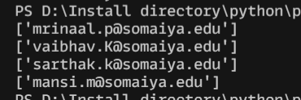

Slide 20
Retrieve data and writing to another file
Import re
F1 = open(‘salaries.txt’,’r’)
F2 = open(‘newfile.txt’,’w’)
For line in f1:
Res1 = re.search(r’\d{4}’,line)
Res2 = re.search(r’\d{4,}.\d{2}’,line)
print(res1.group(),res2.group())
f2.write(res1.group()+”\t”)
f2.write(res2.group()+”\n”)
f1.close()
f2.close()

Slide 21
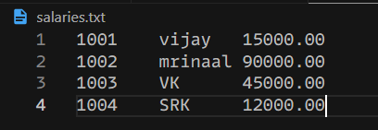
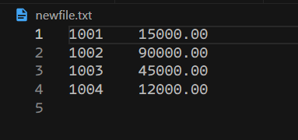

Slide 22
Retrieving Information from HTML FIle
import re
import urllib.request
f = urllib.request.urlopen(r'file:///D:\Install directory\python\ppt\breakfast.html')
text = f.read()
str = text.decode()
result = re.findall(r'<td>(\w+)</td>',str)
print(result)
for item in result:
print('Item = %-15s' %(item))
f.close()

Slide 23
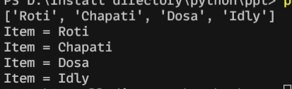

Slide 24
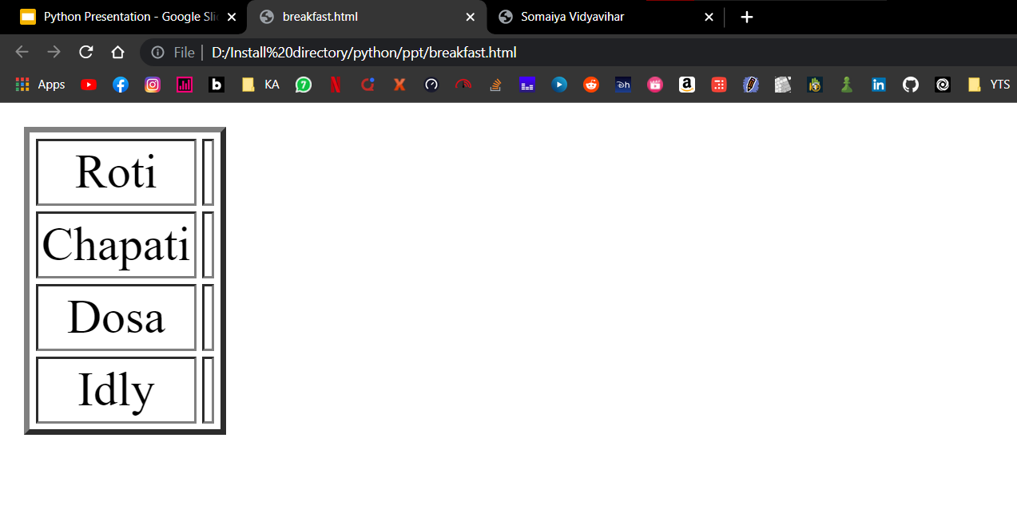

Slide 25
THANK YOU !!

